Slide 1
Security in Emergency Situations
Jun Yi, Yiming Peng

Slide 2

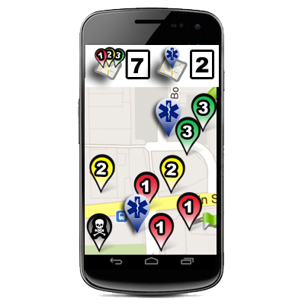

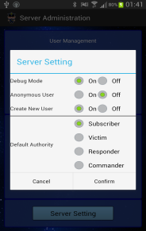


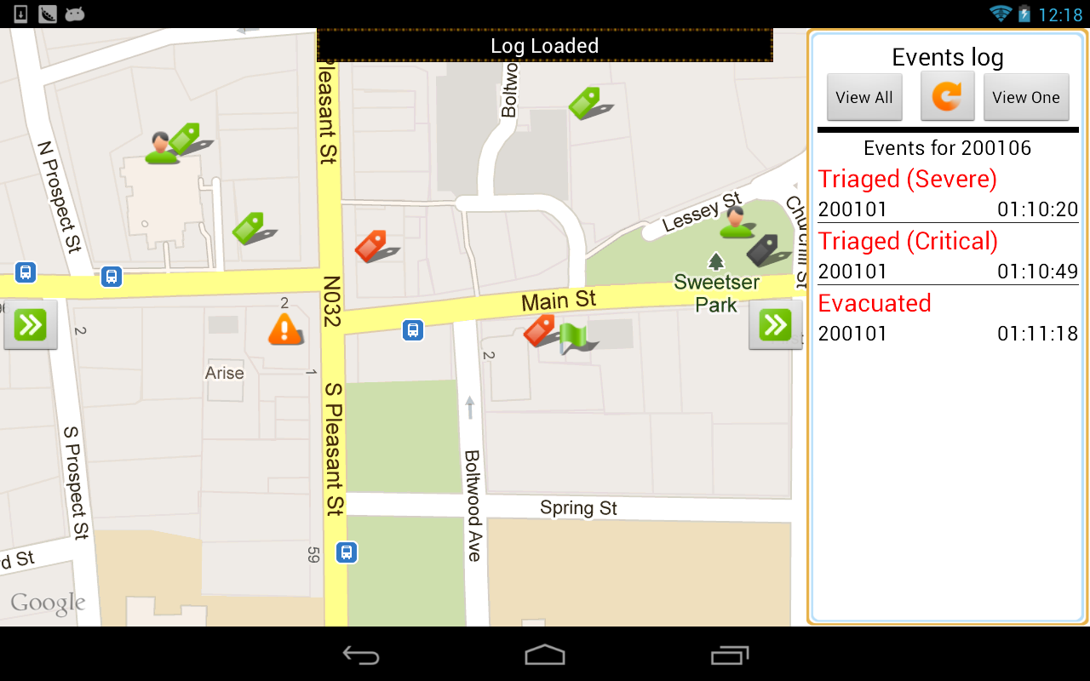






We Need Protection
DDNS
Stealing
Forgery
Brute-Force
Modification
Breaking Password
Webmaster
Eavesdropping
Interception
Modification
Forgery
Masquerade
Stealing
Tracking
Stealing
Responder
Commander

Slide 3
Project Outline
Login and different authorities
Communication encrypted based on Kerberos Algorithm
Database encryption and certification
Friendly UI for server administrator
Security token for administrator login
Three levels of security protection
Security test using different attacks

Slide 4
Security Levels
Purpose
A compromised strategy to balance between responding time (server resources) and security provided.
Level | Access Control | Transmit Encryption | Database Protection
Low | Username Basic Authority Anonymous Allowed | Plaintext | Plaintext
Medium | Username Password Authentication Authority | Encrypted by a session key Authenticator and ticket required | Plaintext
High | Username Password Authentication Authority | Encrypted by a session key Authenticator and ticket required | Encrypted Key never stored with data Certification
Tips:
Each incident has a security level separated from others
The security level of an incident is decided by user when created
Once determined, the security level cannot be changed

Slide 5

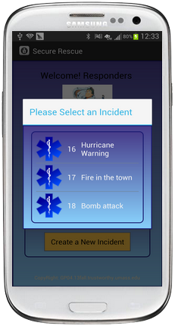
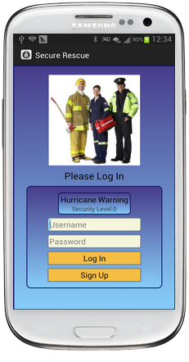
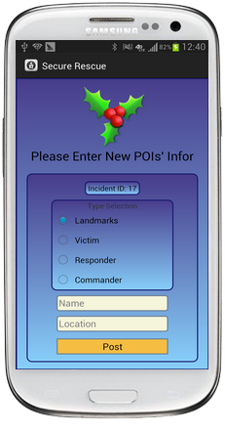
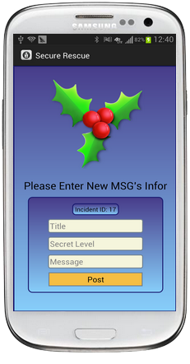
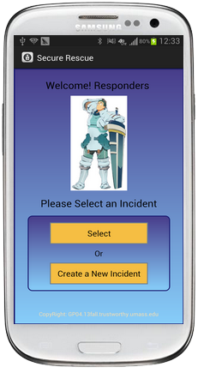
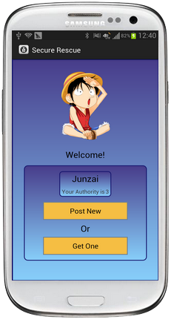
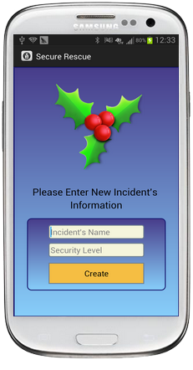
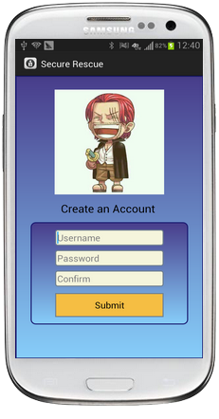
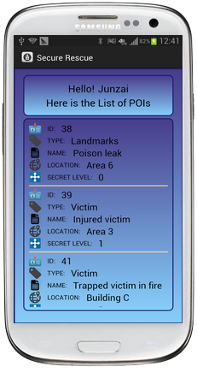
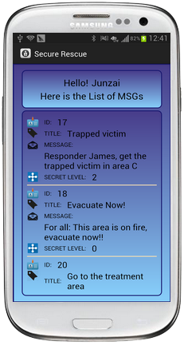
Client Application
Post POIs
Incident Select
Login
Post Message
Get POIs
Welcome
Main
Incident Create
Sign Up
Get Message

Slide 6
Security Level Low
User only has to input a username
Password input field is invalidated
Request is sent to data server in plaintext
Authority is checked in Server
Username
I’m Yiming, I want POI List
Anonymous
Check
You’re authority is 2, I can give
you these POIs…
Query
Send Back
Data Server

Slide 7
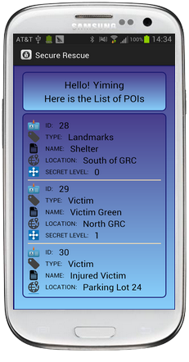
Security Level Low
Anonymous
Anonymous login is an option to the server admin
Once it’s turned on, user can input ANY username to receive data and is treated as authority 0 in server
Only authenticated users can send data
Summary
The simplest login procedure for users
Do not always need to create an account
Forgery is easy when you get someone’s username
Eavesdropping is also easy
Best used at: Alert broadcast, EMT training, etc.
Result

Slide 8

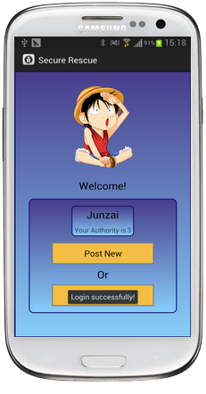
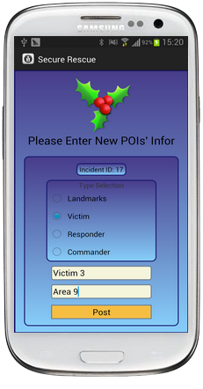



Security Level Medium
Password Error!
Failed
Connect TGS
Authenticator, TGS Ticket
Decrypt
Login Success
Connect AS
Request/Post Data
TGS Ticket, Session Key
Service Ticket, Session Key
Ticket
Authenticator
Username
Kerberos Server
Data Server

Slide 9
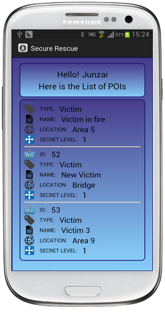
Security Level Medium
Summary
Kerberos Server and Data Server are separated
Both user and server are authenticated through Kerberos procedure
All communication are encrypted by a session key
User’s authority is passed from AS to Data Server through ticket
In both GET and SEND processes, server will check the ticket and authenticator
Data is stored in plaintext in the database
Best used at: Natural disaster, casual incidents, etc.
Result

Slide 10
Security Level High
The database is also encrypted using AES
Service Request
Service Ticket
Check Ticket and Authenticator
Data Server
Encryption Key
Get the Encryption Key
Post
Get
Generate Certificate
Query the database
Kerberos Server
Encrypt new data
Decrypt result
Save into database
Check Certificate
Certificate
Hash value of all the data in that row with some paddings
Send data to client

Slide 11

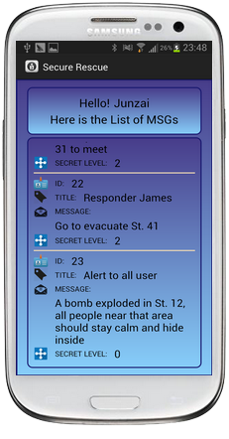
Security Level High
Summary
Database is encrypted using AES
Encryption key is never stored in the data server
The data server is able to decrypt the data only when an authenticated user brings a ticket
Certificate code helps detect the unauthorized changes of data
An attacker cannot understand or forge anything even if he has the full access to the Data Server
Most security resources can be put on Kerberos Server rather than Data Server
Best used at: Terrorist attack, aliens attack, etc.
Result

Slide 12
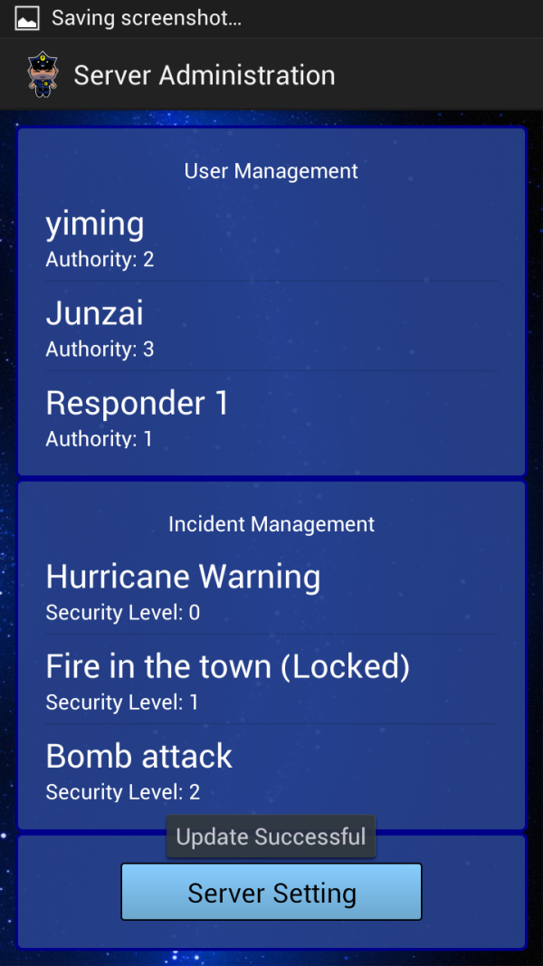
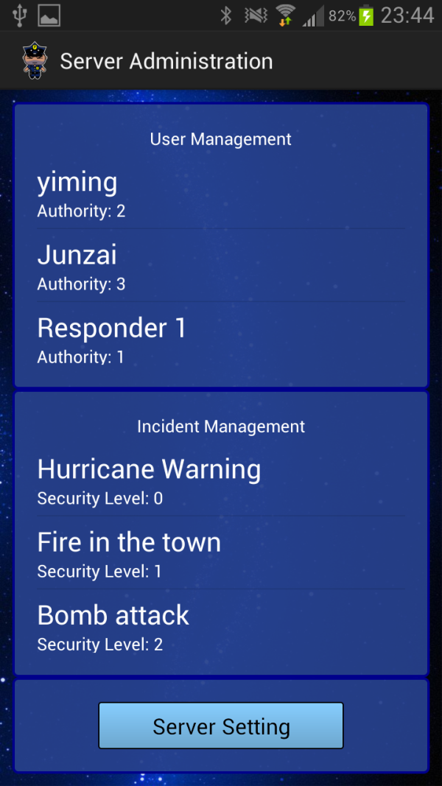
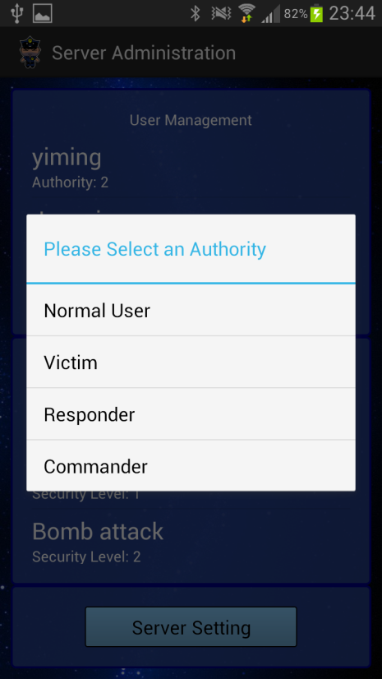

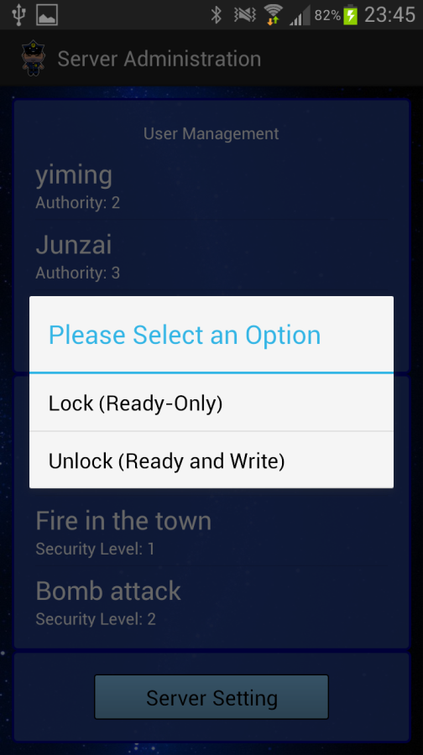
Administrator App
Allows the administrator to manage the server
User Management
View all the users and their authorities
Assign them different authorities
Delete a user (to be implemented)
Incident Management
View all the incidents
Lock the incident to make it read-only
Unlock the incident to make it editable
Server Settings
Result

Slide 13
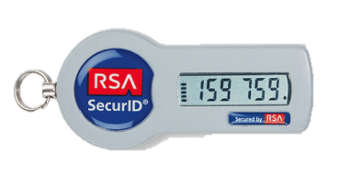
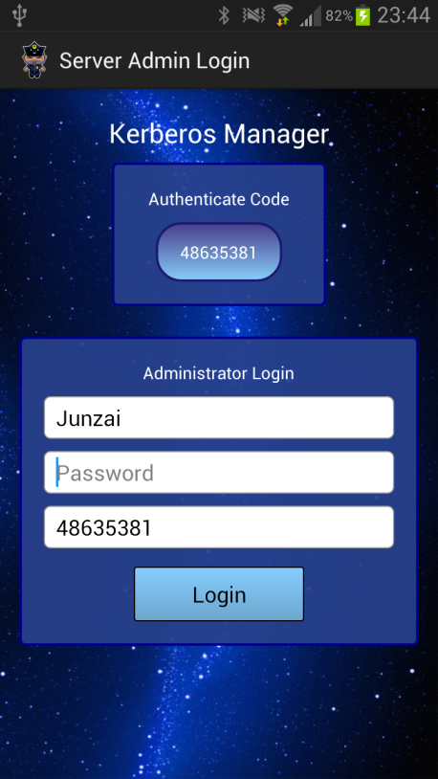
Administrator Login
Authenticate Code (Security Token)
A 6 or 8 digits number code that is generated and refreshed by the client every 30 seconds
The code is unique to every device and every user
Server generates the same code separately and verifies the client’s code before checking the password
Administrator should use his own device in addition to having the password

Slide 14
Authenticate Code
Initialization
Verification
Client
Server
Client
Server
New admin created
New admin created
Application starts
Synchronize
Get system time
Server Time
Send MAC Address
Generate a secret key
Calculate Auth. Code
Calculate Auth. Code
Securely
Calculate the Seed(MD5)
Calculate the Seed(MD5)
User input password
Calculate Auth. Code
Password
Calculate Auth. Code
Code
Verification
Store it in local storage
Store both in the database
Contact TGS
Issue Ticket

Slide 15
Authenticate Code
Code Calculation
Summary
Server Time
Seed
MAC Address
Seed
Only generated once when the app is used at the first time
Stored secretly in local and is not accessible for the user
Authenticate Code
Is calculated separately and is never transmitted through network
Every code can only be used once
Is changed every 30 seconds to prevent replay attack
MAC Address ensures one Seed is fixed to only one device
An attacker cannot log into the server unless he/she gets both the device and password
Hash (MD5 X 2)
128-bit Hash Value
16 bits
16 bits
…
16 bits
…
Mod 10
Mod 10
Mod 10
8-digit Number

Slide 16
Let’s Attack
Sample Incidents
Three Incidents with the same content but different security level from low to high
Each incident contains: 2 landmarks, 4 victims, 1 responder and 1 commander
Target Data
Name | Location
Landmark 1 | Area 1
Landmark 2 | Area 2
Victim 1 | Area 5
Victim 2 | Area 5
Victim 3 | Area 7
Victim 4 | Area 10
Responder 1 | Area 5
Commander | Area 15
Sample Users
A user named Apple with authority Victim
A user named Android with authority Commander
Sample Attacks
Username masquerading
Network sniffing
Data Server intrusion
Brute-Force
Server Setting
Anonymous: Allowed

Slide 17
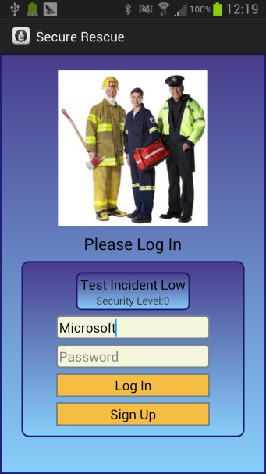
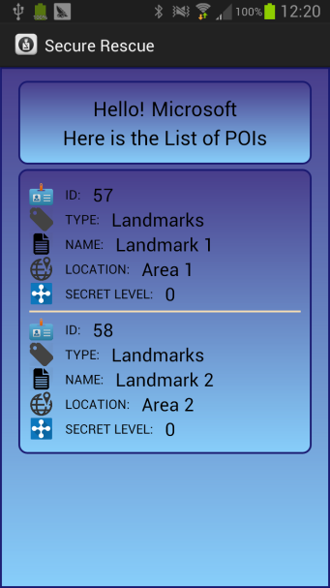
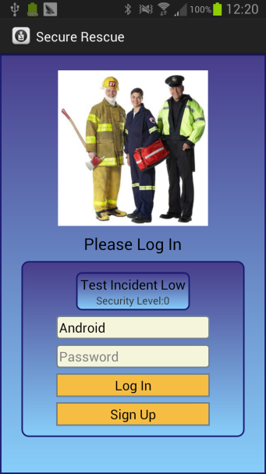
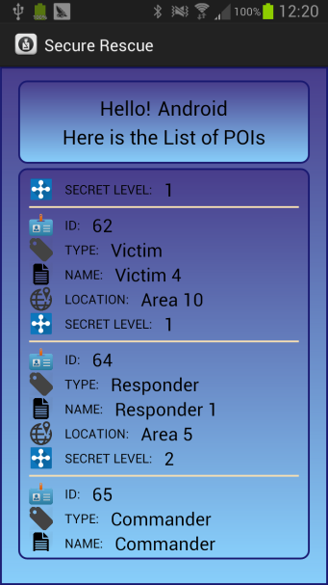

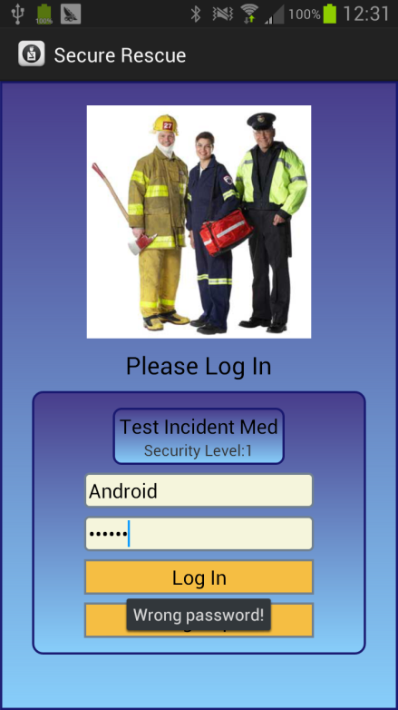
Username Masquerading
Security Level Low
Security Level Medium and High
Password is able to protect user’s account from masquerading and offers authentication to server

Slide 18

Network Sniffing
Wireshark
A software that allows user to see all traffic visible on the network
Can be installed in the server, the router or other workstations in the same LAN (IP Spoofing)
In the test, we login as the user Android and try to get all POIs

Slide 19
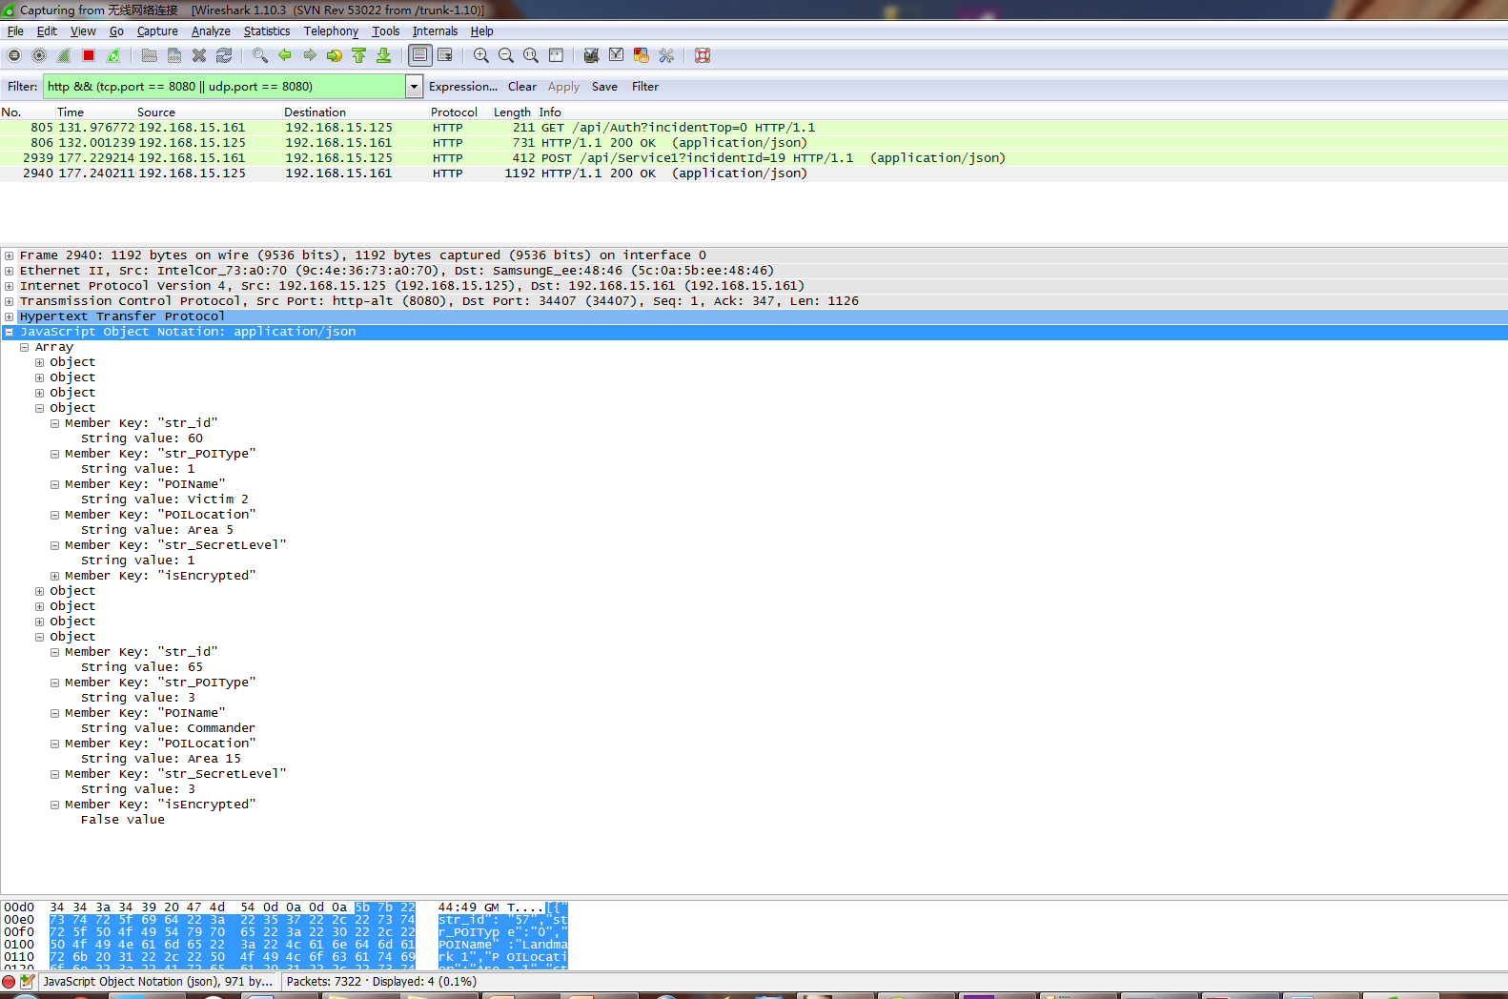
Network Sniffing
Security Level Low
Victims
All information is transmitted in plaintext
Commander

Slide 20
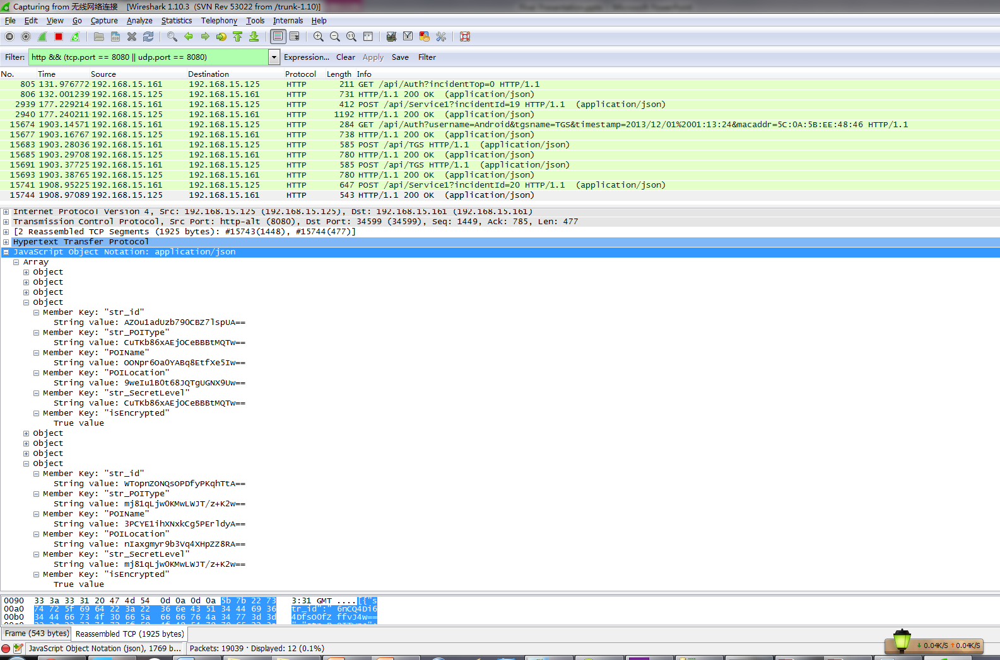
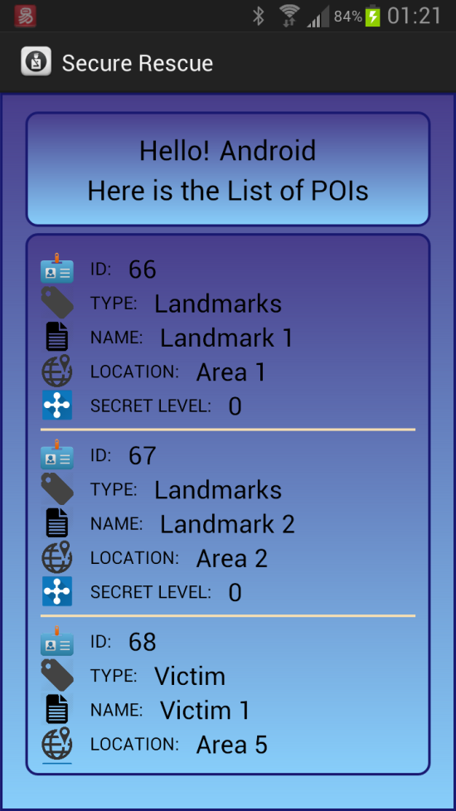
Network Sniffing
Security Level Medium and High
What’s this?
What’s that?
Result

Slide 21
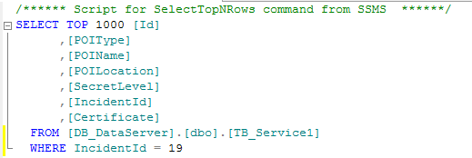
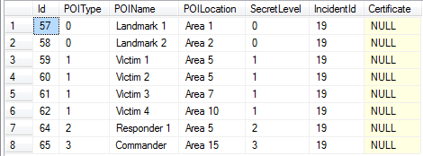
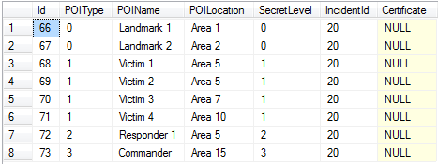
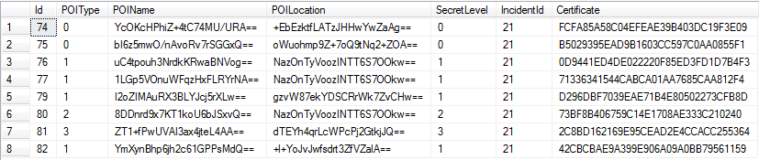
Data Server Intrusion
Security Level Low and Medium
Security Level High

Slide 22
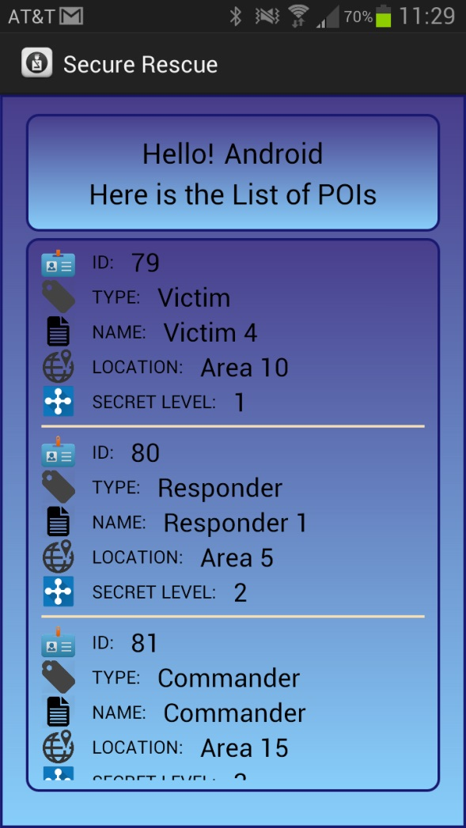
Data Server Intrusion
Summary
The Data Server is encrypted using AES
The key is stored in Kerberos Server
The data is firstly decrypted using the database encryption key and encrypted using Kerberos session key
Certificate helps to detect unauthorized change
Error Log
Result

Slide 23
Brute-Force
Brute-Force?
We have AES-128!

Slide 24
Performance
(Average time of 10 queries)

Slide 25
Protection We Provided
DDNS
Stealing
Forgery
Brute-Force
Modification
Breaking Password
Webmaster
Eavesdropping
Interception
Modification
Forgery
High
Masquerade
Stealing
Medium
Tracking
Stealing
Low
Commander
Responder

Slide 26
Future Work
Ways to enhance Kerberos Server
Extension of Authenticate Code
System efficiency

Slide 27
Thank you!

